Slide 1
Medical Inventory & Inventory Management
Muhammed Asif ali
Anjaneyulu
Rajesh
Arun Kumar

Slide 2
Problem Statement
Need to create an inventory management system for Medical inventory and Expiry tracking system
Should support medications and equiments

Slide 3
Tech Stack
Frontend : ReactJS, JS, TS, HTML, CSS, MUI, ContextAPI
Backend : Java, Spring boot, NodeJs, Express
Database: MongoDB
Authentication: JWT
Deployments: Vercel ( Node )

Slide 4
DB Design
User Table
Name | Role | Email | Password | Is_active | Created_at | Updated_at
Inventory Type
Name | Created_at | Updated_at
Medine
Equipements
utilities

Slide 5
Inventory Table
Name | Type | Quantity | Threshold_quantity | Expiry_date | Created_by | Last_updated_by
 | FK_Inventory_Type
Price | Manufacturing_date | Batch_no | Created_at | Updated_at

Slide 6
Inventory Audit Table
Inventory_id | Audit_type | Audit_value | Updated_by
 | [ADD/UPDATE/DELETE] |  | FK UserTable

Slide 7
API ( Backend )
Auth
Auth/signup
Auth/login
Auth/logout
Inventory
Inventory [POST]
Inventory [PUT]
inventory [GET]
Inventory [DELETE]
Inventory/inventory by id [ GET ]
Inventory/page_no/size/filterby/sort_by [GET]

Slide 8
API ( Backend )
History
History/inventory_id
visualization
Visualization/filter_by/
Request_payload { filter_by : type
}
Response: [{
name:”utility”,
Value: “10”
},…..
]

Slide 9
Frontend
Login
User_name
Password
Login
Signup

Slide 10
Frontend
Signup
Name
mail
Password
Role - Dropdown
Signup
Login

Slide 11
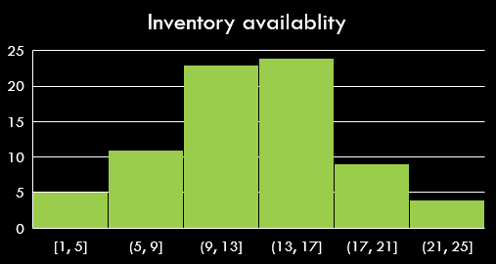
Dashboard
Expiry Sooner List
Search
Name | Type | Quantity | Expiry | Batch | QR Code | Action
 |  |  |  |  | Open Popup | Edit / Delete ( with role )
Low Quantity List

Slide 12

Single Item view
Item Name
Edit
History
Detailed description of the Inventory
No of Quantity available
Bach no
Manufactiring Date
Expiry Date

